Slide 1
SETS

Slide 2
A set is an unordered well defined collection of distinct objects, called elements or members of the set. A set is said to contain its elements. We write a ∈ A to denote that a is an element of the set A. The notation a ∈ A denotes that a is not an element of the set A.
EXAMPLE 1 The set V of all vowels in the English alphabet can be written as
V = {a, e, i, o, u}. EXAMPLE 2 The set O of odd positive integers less than 10 can be expressed by
O = {1, 3, 5, 7, 9}.

Slide 3
Another way to describe a set is to use set builder notation. We characterize all those elements in the set by stating the property or properties they must have to be members. For instance, the set O of all odd positive integers less than 10 can be written as
O = {x | x is an odd positive integer less than 10}, or, specifying the universe as the set of positive integers, as
O = {x ∈ Z+ | x is odd and x < 10}.
We often use this type of notation to describe sets when it is impossible to list all the elements of the set. For instance, the set Q+ of all positive rational numbers can be written as
Q+ = {x ∈ R | x = p /q , for some positive integers p and q}.
Beware that mathematicians disagree whether 0 is a natural number. We consider it quite natural. .

Slide 4
These sets, each denoted using a boldface letter, play an important role in discrete mathematics:
N = {0, 1, 2, 3, . . .}, the set of natural numbers Z = {. . . , −2, −1, 0, 1, 2, . . .}, the set of integers Z+ = {1, 2, 3, . . .}, the set of positive integers Q = {p/q | p ∈ Z, q ∈ Z, and q = 0}, the set of rational numbers R, the set of real numbers R+, the set of positive real numbers C, the set of complex numbers

Slide 5
Two sets are equal if and only if they have the same elements. Therefore, if A and B are sets, then A and B are equal if and only if ∀x(x ∈ A ↔ x ∈ B). We write A = B if A and B are equal sets.
EXAMPLE 6 The sets {1, 3, 5} and {3, 5, 1} are equal, because they have the same elements. Note that the order in which the elements of a set are listed does not matter. Note also that it does not matter if an element of a set is listed more than once, so {1, 3, 3, 3, 5, 5, 5, 5} is the same as the set {1, 3, 5} because they have the same elements.

Slide 6
THE EMPTY SET There is a special set that has no elements. This set is called the empty set,or null set, and is denoted by ∅. The empty set can also be denoted by { } (that is, we represent the empty set with a pair of braces that encloses all the elements in this set). Often, a set of elements with certain properties turns out to be the null set. For instance, the set of all positive integers that are greater than their squares is the null set.
A set with one element is called a singleton set. A common error is to confuse the empty {∅} has one more element than ∅. set ∅ with the set {∅}, which is a singleton set. The single element of the set {∅} is the empty set itself!

Slide 7
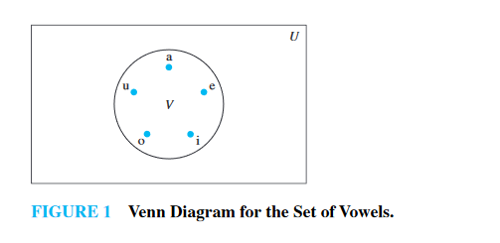
Venn Diagrams
Sets can be represented graphically using Venn diagrams, named after the English mathematician John Venn, who introduced their use in 1881. In Venn diagrams the universal set U, which contains all the objects under consideration, is represented by a rectangle. (Note that the uni- versal set varies depending on which objects are of interest.) Inside this rectangle, circles or other geometrical figures are used to represent sets. Sometimes points are used to represent the particular elements of the set. Venn diagrams are often used to indicate the relationships between sets. We show how a Venn diagram can be used in Example 7. EXAMPLE 7 Draw a Venn diagram that represents V, the set of vowels in the English alphabet. Solution: We draw a rectangle to indicate the universal set U , which is the set of the 26 letters of the English alphabet. Inside this rectangle we draw a circle to represent V . Inside this circle we indicate the elements of V with points (see Figure 1).

Slide 8
The set A is a subset of B if and only if every element of A is also an element of B. We use the notation A ⊆ B to indicate that A is a subset of the set B.
The set of all odd positive integers less than 10 is a subset of the set of all positive integers less than 10, the set of rational numbers is a subset of the set of real numbers, the set of all computer science majors at your school is a subset of the set of all students at your school, and the set of all people in China is a subset of the set of all people in China (that is, it is a subset of itself). Each of these facts follows immediately by noting that an element that belongs to the first set in each pair of sets also belongs to the second set in that pair.

Slide 9
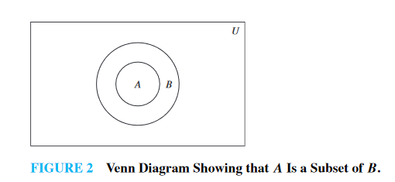
Sets may have other sets as members. For instance, we have the sets A = {∅, {a}, {b}, {a, b}} and B = {x | x is a subset of the set {a, b}}. Note that these two sets are equal, that is, A = B. Also note that {a} ∈ A, but a /∈ A.

Slide 10
Let S be a set. If there are exactly n distinct elements in S where n is a nonnegative integer, we say that S is a finite set and that n is the cardinality of S. The cardinality of S is denoted by |S|.
Let A be the set of odd positive integers less than 10. Then |A| = 5. Let S be the set of letters in the English alphabet. Then |S| = 26. Because the null set has no elements, it follows that |∅| = 0.

Slide 11
Given a set S, the power set of S is the set of all subsets of the set S. The power set of S is denoted by P(S).
What is the power set of the set {0, 1, 2}? Solution: The power set P({0, 1, 2}) is the set of all subsets of {0, 1, 2}. Hence, P({0, 1, 2}) = {∅, {0}, {1}, {2}, {0, 1}, {0, 2}, {1, 2}, {0, 1, 2}}. Note that the empty set and the set itself are members of this set of subsets. EXAMPLE 15 What is the power set of the empty set? What is the power set of the set {∅}? Solution: The empty set has exactly one subset, namely, itself. Consequently, P(∅) = {∅}. The set {∅} has exactly two subsets, namely, ∅ and the set {∅} itself. Therefore, P({∅}) = {∅, {∅}}. If a set has n elements, then its power set has 2n elements. We will demonstrate this fact in several ways in subsequent sections of the text.

Slide 12
Cartesian Products The order of elements in a collection is often important. Because sets are unordered, a different structure is needed to represent ordered collections. This is provided by ordered n-tuples.
The ordered n-tuple (a1, a2, . . . , an ) is the ordered collection that has a1 as its first element, a2 as its second element, . . . , and an as its nth element.
What is the Cartesian product of A = {1, 2} and B = {a, b, c}? Solution: The Cartesian product A × B is A × B = {(1, a), (1, b), (1, c), (2, a), (2, b), (2, c)}.

Slide 13
Show that the Cartesian product B × A is not equal to the Cartesian product A × B, where A and B are as in Example 17. Solution: The Cartesian product B × A is B × A = {(a, 1), (a, 2), (b, 1), (b, 2), (c, 1), (c, 2)}.
What is the Cartesian product A × B × C, where A = {0, 1}, B = {1, 2}, and C = {0, 1, 2} ? Solution: The Cartesian product A × B × C consists of all ordered triples (a, b, c), where a ∈ A, b ∈ B, and c ∈ C. Hence,
A × B × C = {(0, 1, 0), (0, 1, 1), (0, 1, 2), (0, 2, 0), (0, 2, 1), (0, 2, 2), (1, 1, 0), (1, 1, 1), (1, 1, 2), (1, 2, 0), (1, 2, 1), (1, 2, 2)}.

Slide 14
Let A and B be sets. The union of the sets A and B, denoted by A ∪ B, is the set that contains those elements that are either in A or in B, or in both.
An element x belongs to the union of the sets A and B if and only if x belongs to A or x belongs to B. This tells us that A ∪ B = {x | x ∈ A ∨ x ∈ B}.
The union of the sets {1, 3, 5} and {1, 2, 3} is the set {1, 2, 3, 5}; that is, {1, 3, 5} ∪ {1, 2, 3} = {1, 2, 3, 5}. The union of the set of all computer science majors at your school and the set of all mathematics majors at your school is the set of students at your school who are majoring either in mathematics or in computer science (or in both).

Slide 15
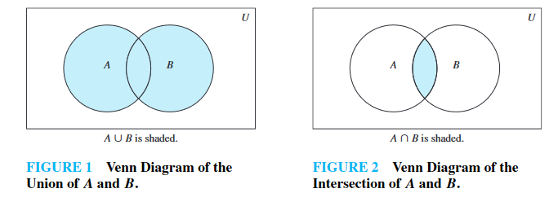
Let A and B be sets. The intersection of the sets A and B, denoted by A ∩ B, is the set containing those elements in both A and B. An element x belongs to the intersection of the sets A and B if and only if x belongs to A and x belongs to B. This tells us that
A ∩ B = {x | x ∈ A ∧ x ∈ B}.

Slide 16
The intersection of the sets {1, 3, 5} and {1, 2, 3} is the set {1, 3}; that is, {1, 3, 5} ∩ {1, 2, 3} = {1, 3}. The intersection of the set of all computer science majors at your school and the set of all mathematics majors is the set of all students who are joint majors in mathematics and computer science.
Two sets are called disjoint if their intersection is the empty set.
Let A = {1, 3, 5, 7, 9} and B = {2, 4, 6, 8, 10}. Because A ∩ B = ∅,
A and B are disjoint.

Slide 17
We are often interested in finding the cardinality of a union of two finite sets A and B. Note that |A| + |B| counts each element that is in A but not in B or in B but not in A exactly once, Be careful not to overcount! and each element that is in both A and B exactly twice. Thus, if the number of elements that are in both A and B is subtracted from |A| + |B|, elements in A ∩ B will be counted only once. Hence, |A ∪ B| = |A| + |B| − |A ∩ B|.

Slide 18
Let A and B be sets. The difference of A and B, denoted by A − B, is the set containing those elements that are in A but not in B. The difference of A and B is also called the complement of B with respect to A.
Remark: The difference of sets A and B is sometimes denoted by A\B. An element x belongs to the difference of A and B if and only if x ∈ A and x /∈ B. This tells us that A − B = {x | x ∈ A ∧ x /∈ B}.
The difference of {1, 3, 5} and {1, 2, 3} is the set {5}; that is, {1, 3, 5} − {1, 2, 3} = {5}. This is different from the difference of {1, 2, 3} and {1, 3, 5}, which is the set {2}. The difference of the set of computer science majors at your school and the set of mathematics majors at your school is the set of all computer science majors at your school who are not also mathematics majors.

Slide 19
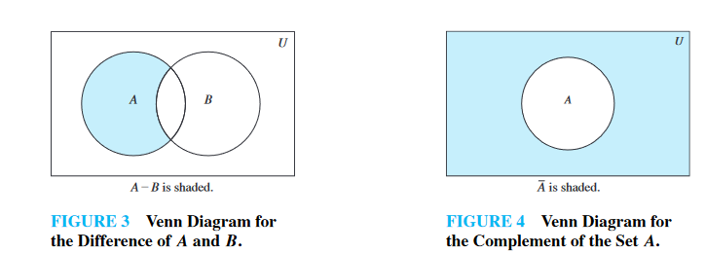

Slide 20
Let U be the universal set. The complement of the set A, denoted by A, is the complement of A with respect to U . Therefore, the complement of the set A is U − A.
An element belongs to A if and only if x /∈ A. This tells us that A = {x ∈ U | x /∈ A}.
Let A = {a, e, i, o, u} (where the universal set is the set of letters of the English alphabet). Then A = {b, c, d, f, g, h, j, k, l, m, n, p, q, r, s, t, v, w, x, y, z}. Let A be the set of positive integers greater than 10 (with universal set the set of all positive integers). Then A = {1, 2, 3, 4, 5, 6, 7, 8, 9, 10}.

Slide 21
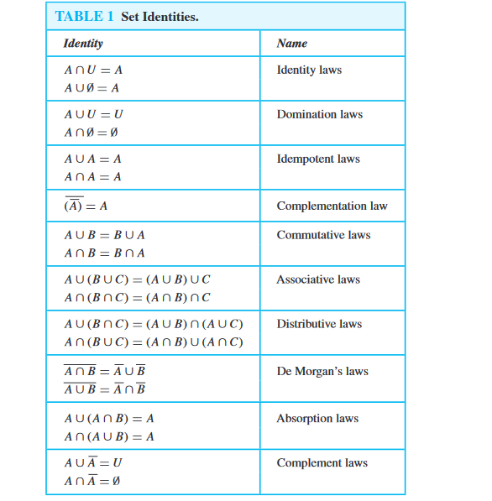

Slide 22
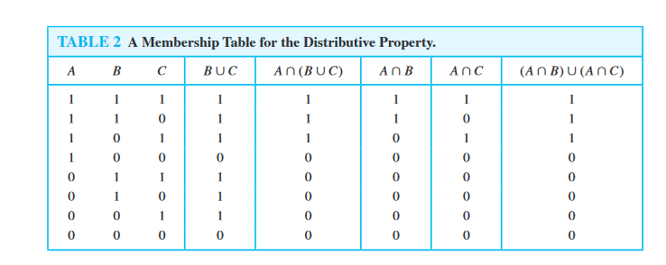

Slide 23
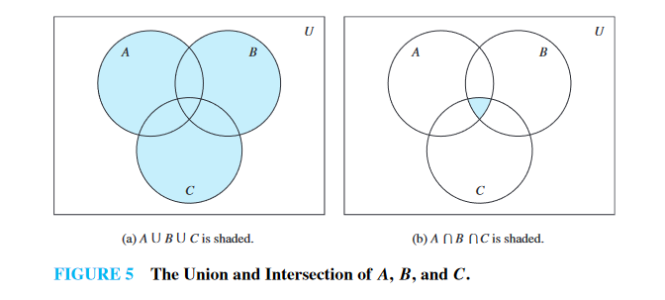

Slide 24
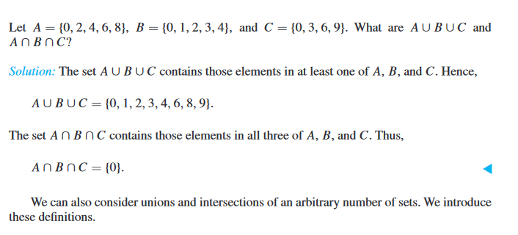

Slide 25
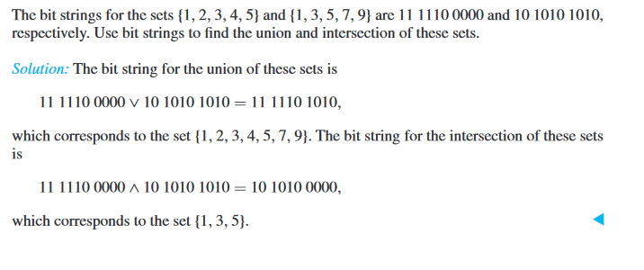

Slide 26
Let A be the set of students who live within one mile of school and let B be the set of students who walk to classes. Describe the students in each of these sets.
a) A ∩ B b) A ∪ B c) A − B d) B − A
a) the set of students who live within one mile of school and walk to class (only students who do both of these things are in the intersection) b) the set of students who either live within one mile of school or walk to class (or, it goes without saying, both) c) the set of students who live within one mile of school but do not walk to class d) the set of students who live more than a mile from school but nevertheless walk to class

